Slide 1
Web APIs
Module 19

Slide 2
Intro

Slide 3
What is a Web API?
API: Application Programming Interface
A browser API extends the functionality of a web browser
A server API extends the functionality of a server

Slide 4
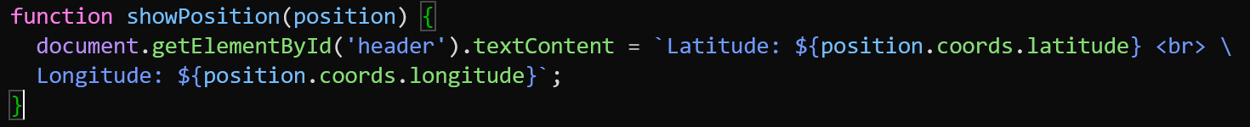
Browser APIs
All browsers have a set of built in Web APIs to support complex operations and to help with accessing data
Example: The Geolocation API can return a browser’s coordinates

Slide 5
Third Party APIs
You will have to download Third Party API code to use it, but once you do you will gain access to information from many different companies code bases
Fun and Useful APIs:
YouTube API: Display YouTube videos in your website
Twitter API: Display Tweets in your website (no longer free)
Spotify API: Display/use Spotify Tracks in your website

Slide 6
Web History API

Slide 7
Web History API
We have actually already used the History API when we worked with window.history’s back() and forward() methods
The History API helps you keep track of the websites you have been to and cycle between them

Slide 8

Web History API Methods
window.history.back()
Works the same way as clicking the back button in your browser
window.history.forward()
Works the same way as clicking the forward button in your browser
window.history.go()
Loads a specific url from the history list
Takes a Number as a parameter: negative for going backwards, positive for forwards

Slide 9
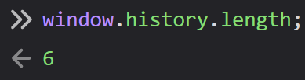
Web History API Properties
length:
Returns the number of URLs in the history list

Slide 10
Web Storage API

Slide 11

Web Storage API
The Web Storage API simplifies the process of storing and retrieving data in the browser
This API is supported by all modern browsers

Slide 12
The localStorage Object
The localStorage object provides access to local storage for the web sites you use the API with
Allows you to read, store, add, delete, or modify data items for a domain
This storage is not deleted when you exit the page and has no expiration

Slide 13

The setItem() Method
The localStorage.setItem() method adds a piece of data to storage
It takes the name of the data and the value of the data as parameters

Slide 14

The getItem() Method
The localStorage.getItem() method retrieves a piece of data from storage
It takes the name of the data you are accessing as a parameter

Slide 15

The sessionStorage Object
The sessionStorage object is identical to the localStorage object, but only stores data for a single session
All methods/properties are the same as localStorage, but all data gets deleted when the browser is closed

Slide 16
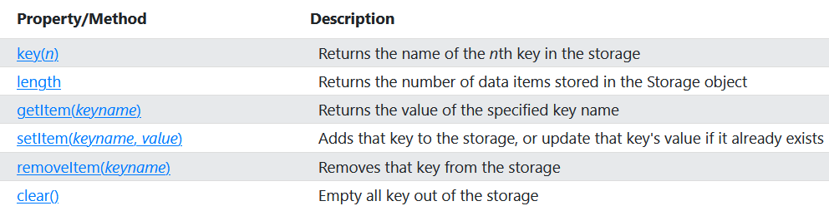
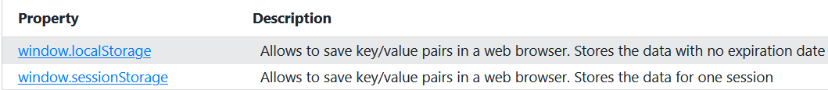
Storage Object Properties and Methods

Slide 17
Web Worker API

Slide 18
What is a Web Worker?
When you call synchronous code in an HTML page, the page is unresponsive until it finishes running
A Web Worker is a JS that runs in the background, independently of other scripts
Users can continue doing things on the page while the Web Worker runs

Slide 19
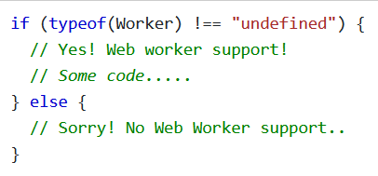
Web Worker Support
Web Workers gained support by modern browsers between 2009 – 2012, but very old browsers may not be able to use them.
The example below shows how to check whether a browser supports The Web Worker API

Slide 20
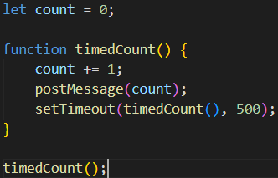
Creating a Web Worker File
Let’s create our Web Worker in an external file
It will count up until it is stopped
This file is working in the background and uses postMessage() to communicate with the foreground

Slide 21

Creating a Web Worker Object
Your Web Worker Object will call an external script to run in the background
Once a Worker has been created, it will run the code in example.js
Now we are able to send messages between our main file and example.js

Slide 22

Creating a Web Worker Object
To let our files communicate, let’s add an onmessage event handler to the Web Worker
Every time the Worker runs the function timedCount(),it will call the postMessage() method
The Worker’s data is stored in event.data

Slide 23

Terminate a Worker
All Workers must consume resources to execute code
Once you have a Worker, it will continue listening for messages until you deliberately remove the Worker.
Terminating Workers frees up your computer’s resources

Slide 24
Reusing a Worker
You can reuse the code for a Web Worker by setting it to undefined after you have terminated it
This lets you reuse the same code

Slide 25
Web Workers
All web workers are used in external files
Since they are not included in your HTML document’s script element, they will not have access to the window object, the parent object, or the Document object.

Slide 26
Fetch API

Slide 27
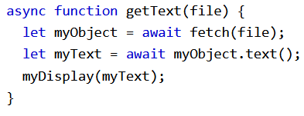

The Fetch API
The Fetch API allows browsers to make HTTP Requests to Web Servers
The syntax is much simpler and easier than with XMLHttpRequests

Slide 28
fetch()
fetch(url, options):
url: A url for a file or a relative path (Access across domains is restricted by default)
options: An object literal you create with the options you want for the request including HTTP Method, headers, body, and several others
fetch defaults to using a GET Request, so you do not ever need to specify that you are using one

Slide 29
Using fetch()
fetch() works just like a Promise and is used with Promise methods like .then() and .catch().
You generally use .then() at least twice
The first then(response) has a Response object as a parameter, which represents the response as a parameter

Slide 30
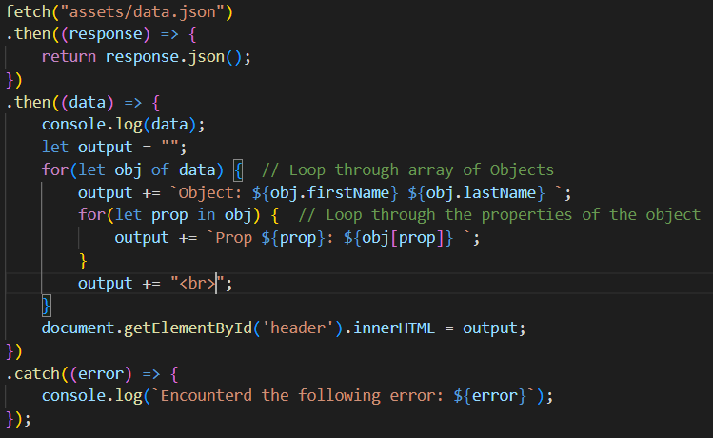
fetch() Example

Slide 31
Web Geolocation API

Slide 32
Web Geolocation API
The Web Geolocation API is used to get the geographical position of a user
For privacy, users must accept your website using location for it to be available
Geolocation is most accurate on devices with GPS, like smartphones but not necessarily desktops or laptops

Slide 33
Using the Geolocation API
The getCurrentPosition(success, failure) method is used to return the user’s position
success: A callback function to be used if location is available
failure (optional): A callback function to be used if location is unavailable (there is an Error)
The success callback has its own parameter position, which has information

Slide 34
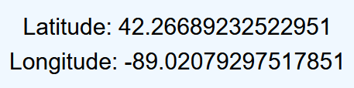
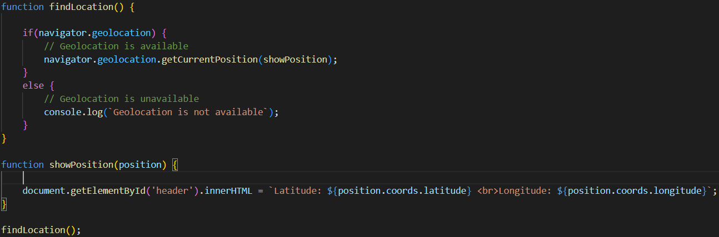
Geolocation API Example

Slide 35
Position Object
Contains information on the user’s position
Two parameters:
coords: A Coordinates object that holds the location coordinates and related information
timestamp: A value representing the time the location was retrieved

Slide 36
The coords Property of Position
coords has the following properties:
latitude: The client’s latitude in decimal degrees
longitude: The client’s longitude in decimal degrees
altitude: The client’s altitude (may not be available for all locations)
accuracy: The estimated accuracy of the longitude and latitude in meters
altitudeAccuracy: The accuracy of the position’s altitude, represented in meters
heading: The direction the device is traveling in, specified in degrees relative to true north (0/360 degrees)
speed: The current ground speed of the device in meters/second

Slide 37
Geolocation Object – Interesting Methods
watchPosition(): Returns the current position of the user and continues to return its position as it moves (like a car’s GPS)
clearWatch(): Stops the watchPosition() method

